Slide 1
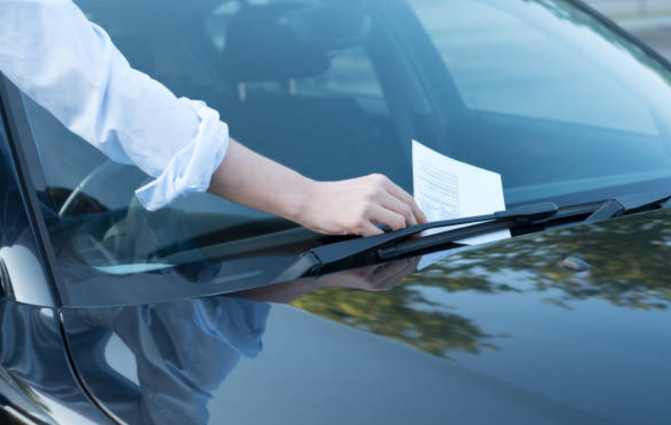
Toronto Car Parking EDA

Slide 2
Data Set description
2.8 Million Car parking tickets across city of Toronto
Published by Revenue service.
Only limits to complete records.

Slide 3
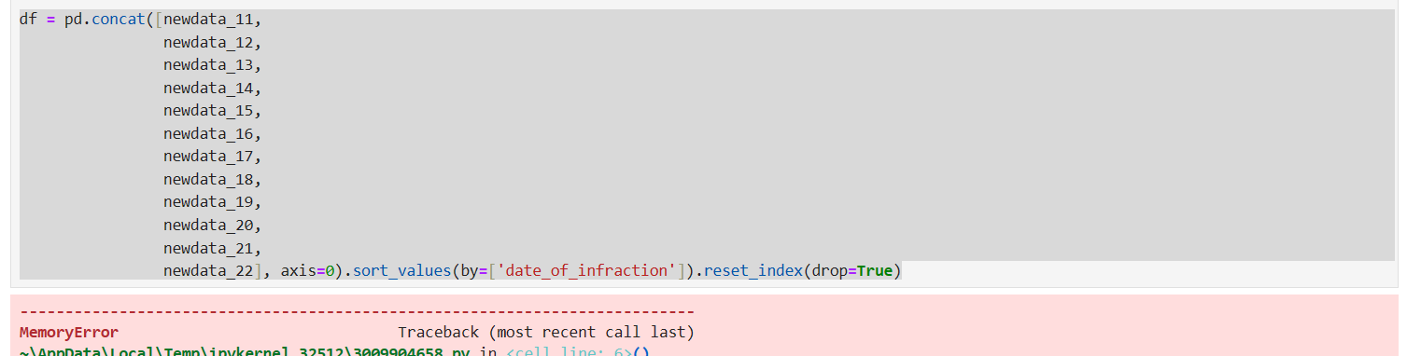
Limitations or challenges
Huge Dataset, EDA is not possible for the whole dataset due to the various reasons.
Even though data is taken as input in chunks to increase the computational optimization, memory allocation is not improved for jupyter notebook in local. Kernel Died. Jupyter lab memory capacity is 3.2GB only.
2010, 2021 Data is consistent with the columns and many of the cells were broken in intermittent lines.
Needed maybe more time to introspect and cleaning. 2021 data formatting was wrong which will take more time.

Slide 4
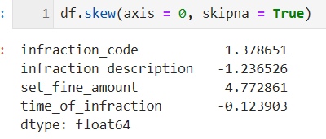
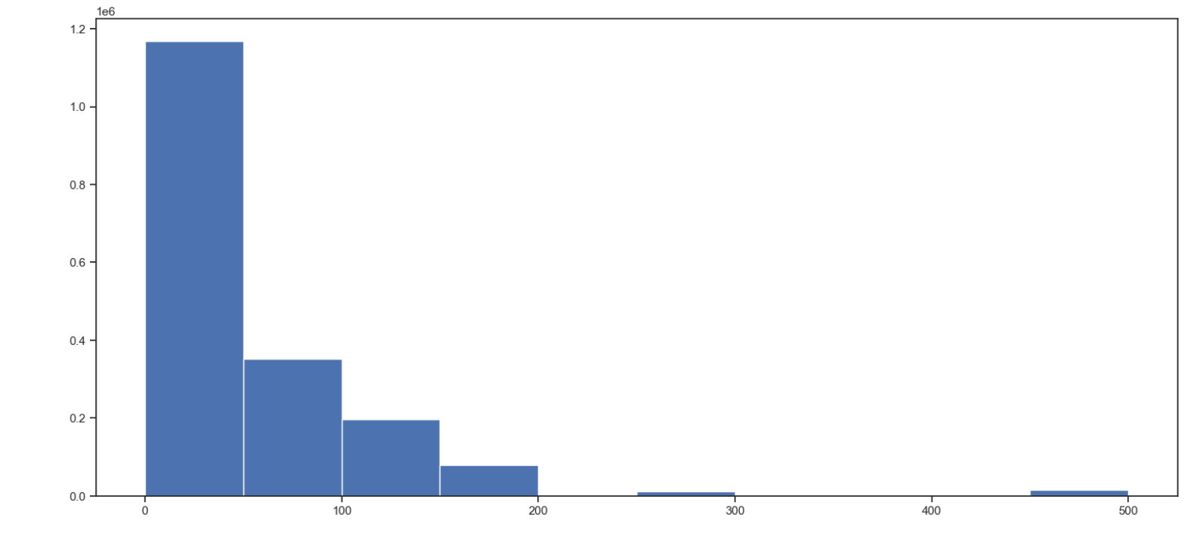
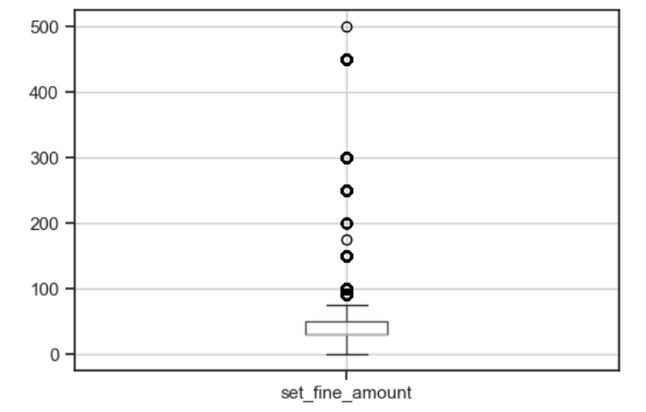
Main Property of the Data ( Last year 2022)
Highly Skewed data as all records are taken from Toronto Car parking fine records and only one set of fine amounts are described for all years.

Slide 5
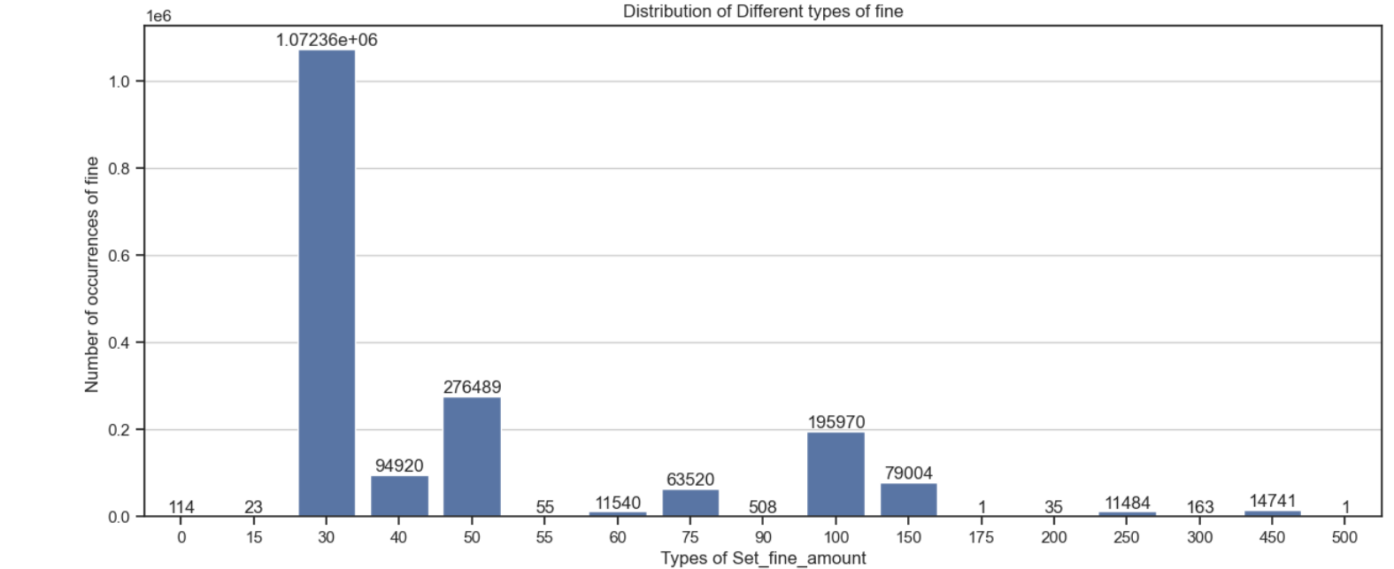
Lets check some pattern in the fine
Lets see the number of occurrences for different types of fines.

Slide 6
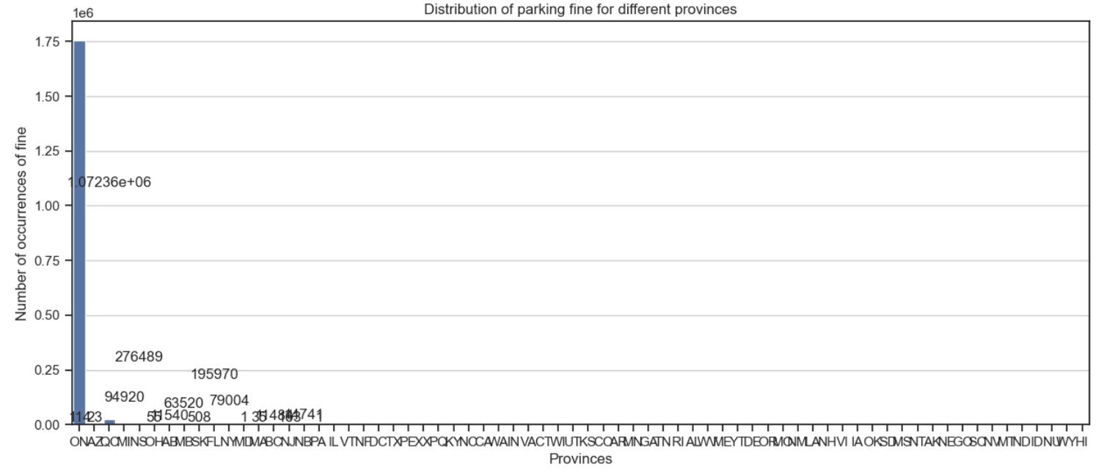
Now Lets check which provinces has the most occurrence.

Slide 7
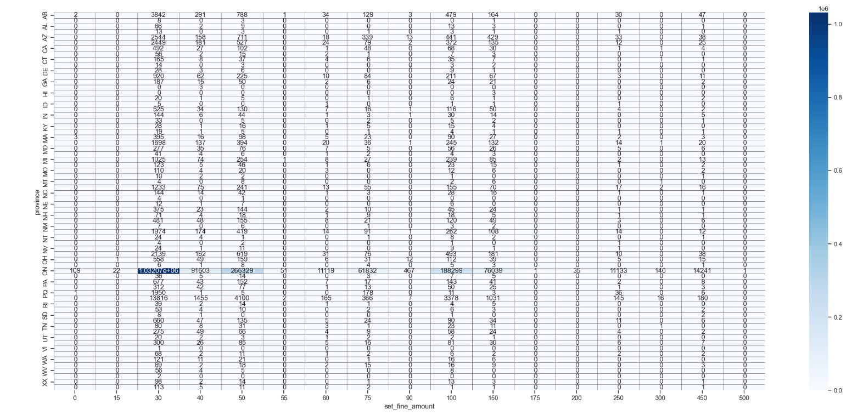
Now lets see the mapping is correct between the fine type and the province.

Slide 8
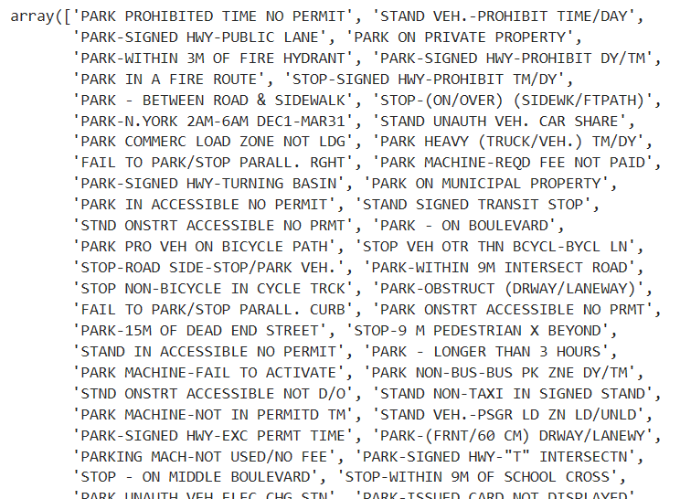
Now lets check the reason of the fines
Several categories for reasons.
Tried to shorten the categorical
Umbrella for different reasons.
Disadvantages:
Hard to fit in a categorical feature.

Slide 9
Change the parking reasons
Change the parking reason description
Based on starting keyword. 9 types of different starting word only happen. Example:
Park = parking ticket was handed due to car park in wrong manner
Stop = car parked wrong in front of the stop sign/ stopped unintentionally
Standby = Car was ready to move but still standing
Failed parking = The car parked in improper manner.

Slide 10
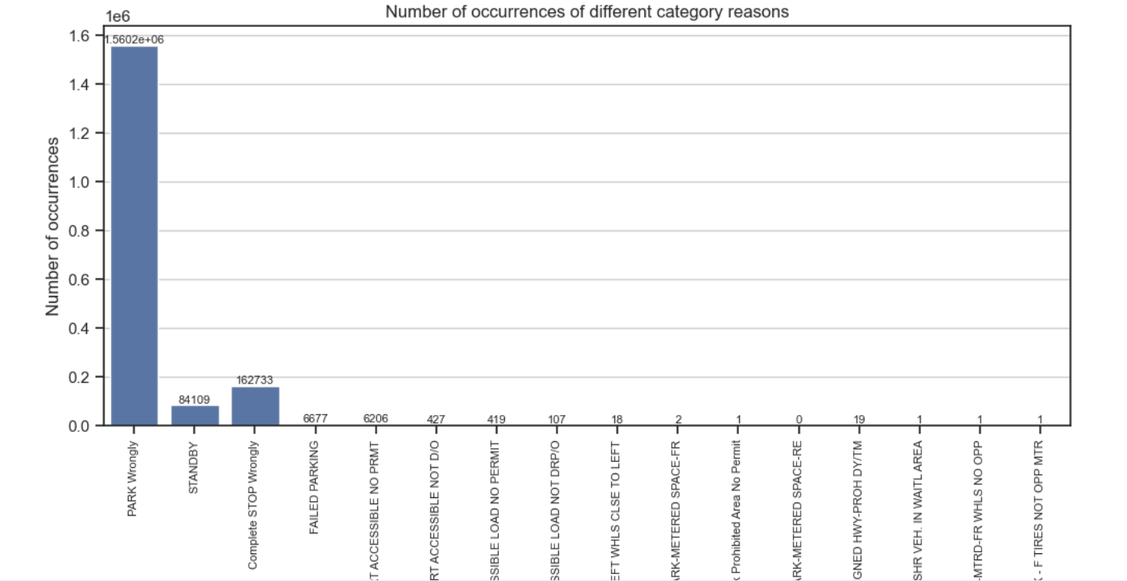
After changing description check distribution of occurrences of different category reasons

Slide 11
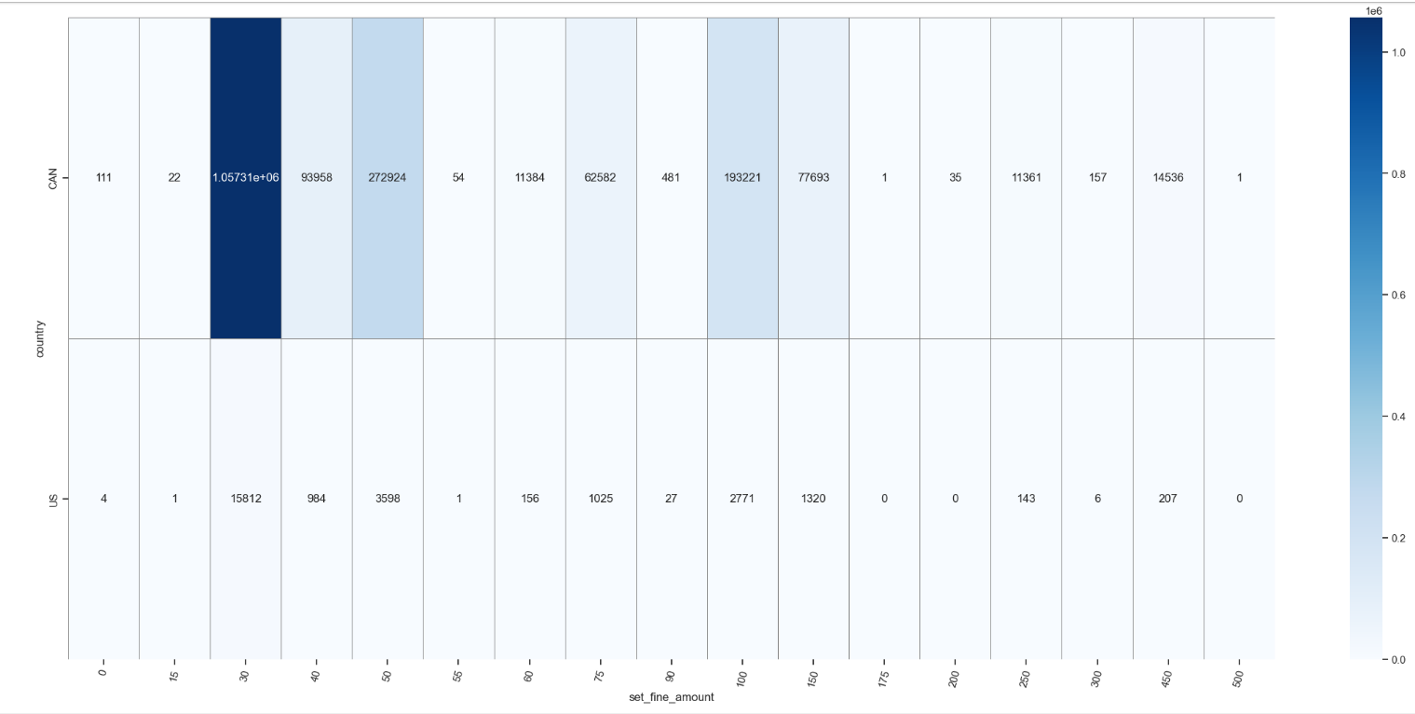
There are some cars from US too. Lets check the Distribution.

Slide 12
1st Result
So it can be concluded that most fines happened in CANADA Ontario which is for 30 CAD due to park wrongly.

Slide 13
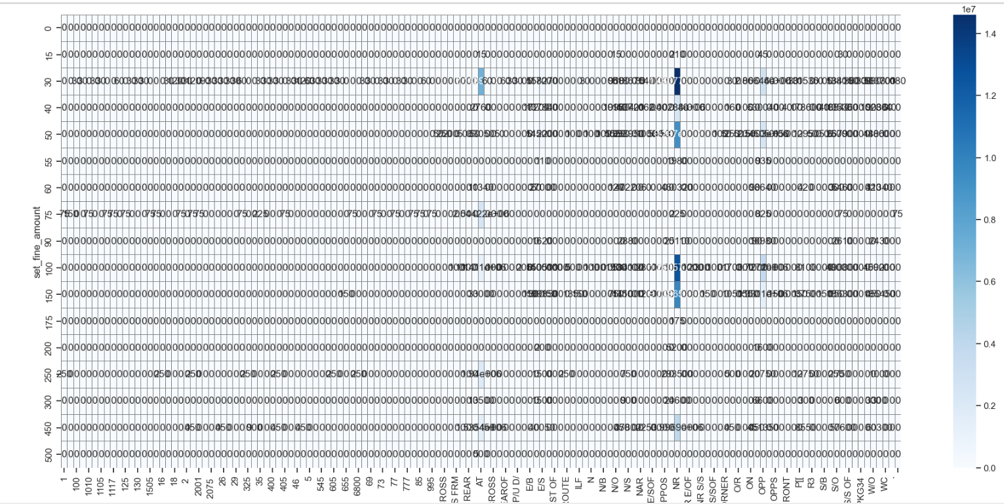
Now lets check which area tag for those fines are affected. Area Tag “NR” is mostly affected

Slide 14
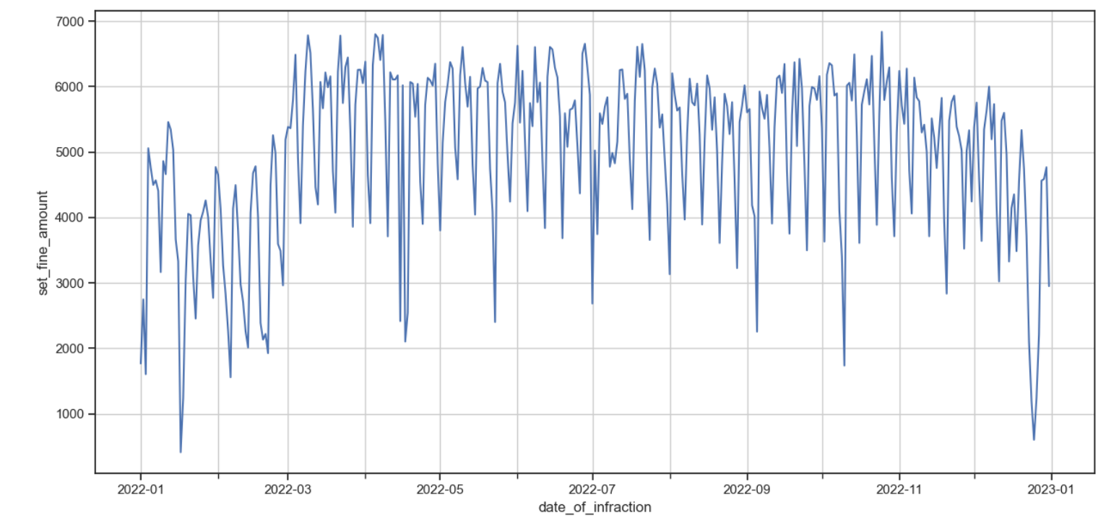
Time Series Visualization for 365 days

Slide 15
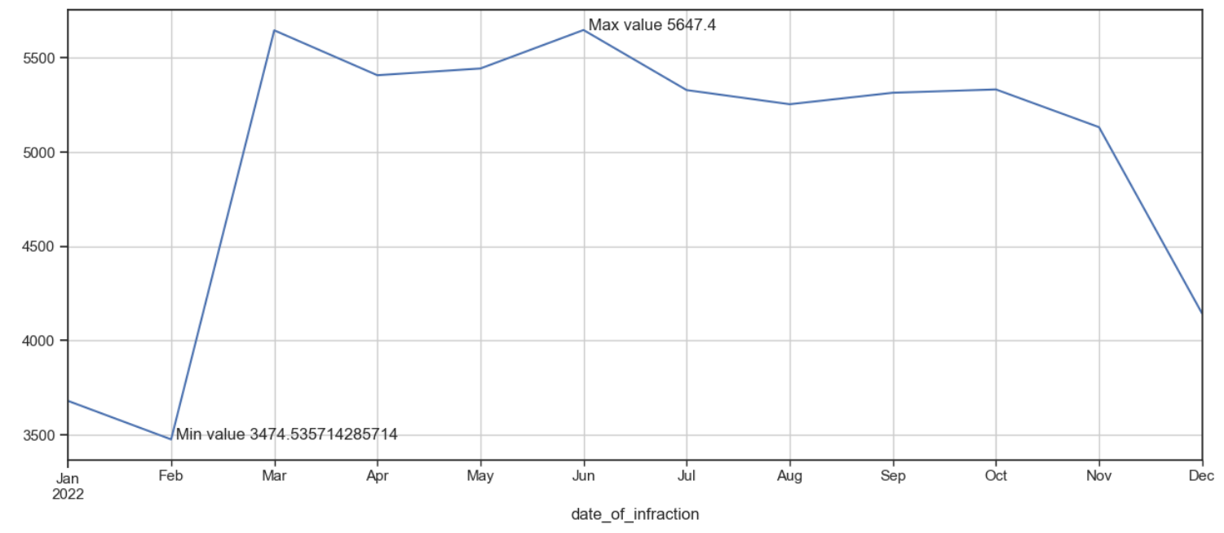
Compute Max and Min Average in last Year Top 3 months of last year( 2022 ) Jun, Mar, July( By Ranking )

Slide 16
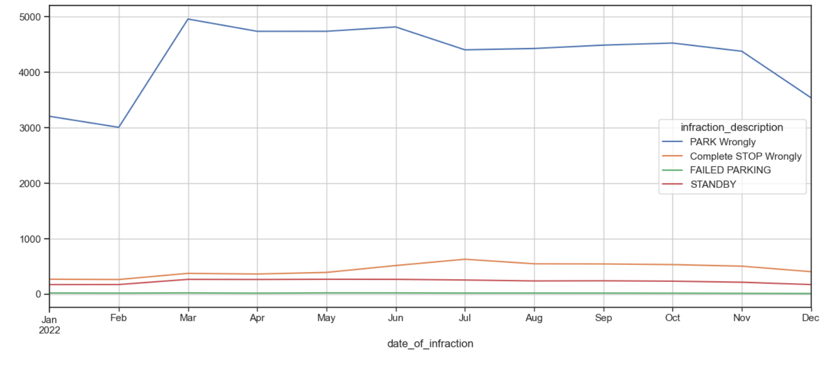
Different Types of fine along with the time series. We choose top 4 reasons as data the data is skewed.

Slide 17
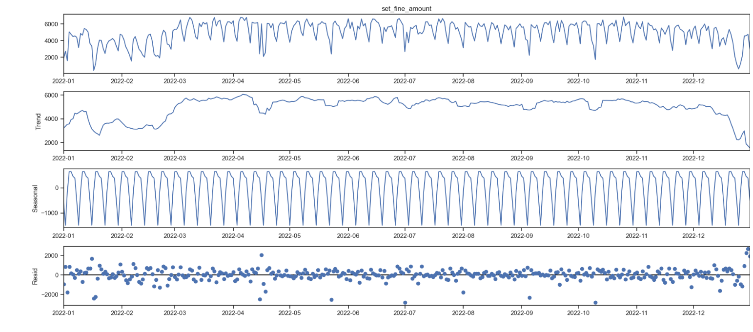
Check seasonal decomposition and plot diagnostics.

Slide 18
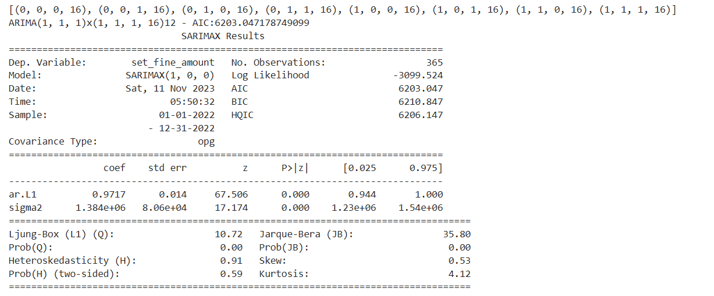
Plot Diagnostics

Slide 19
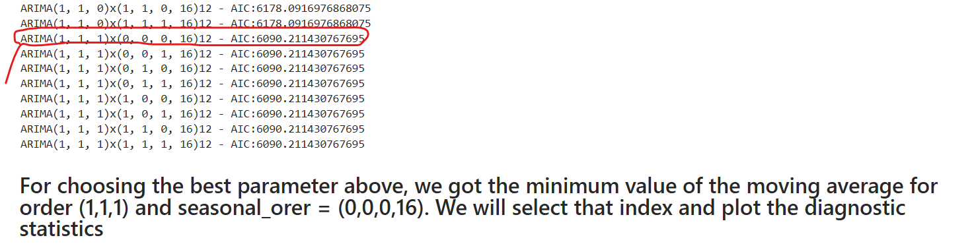
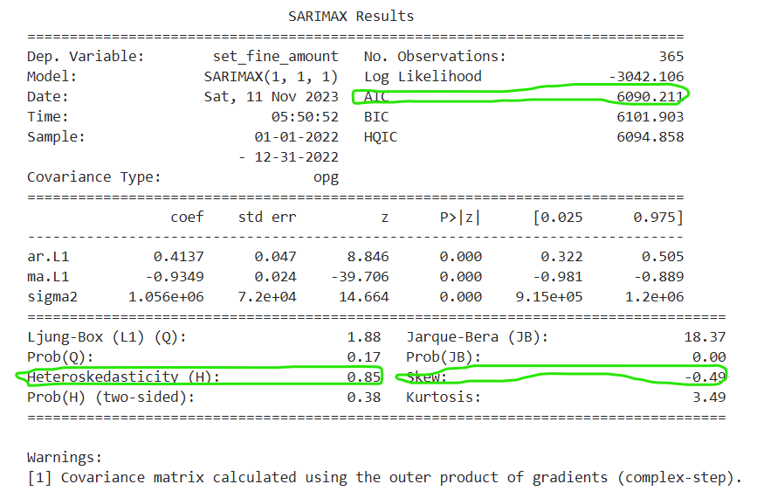
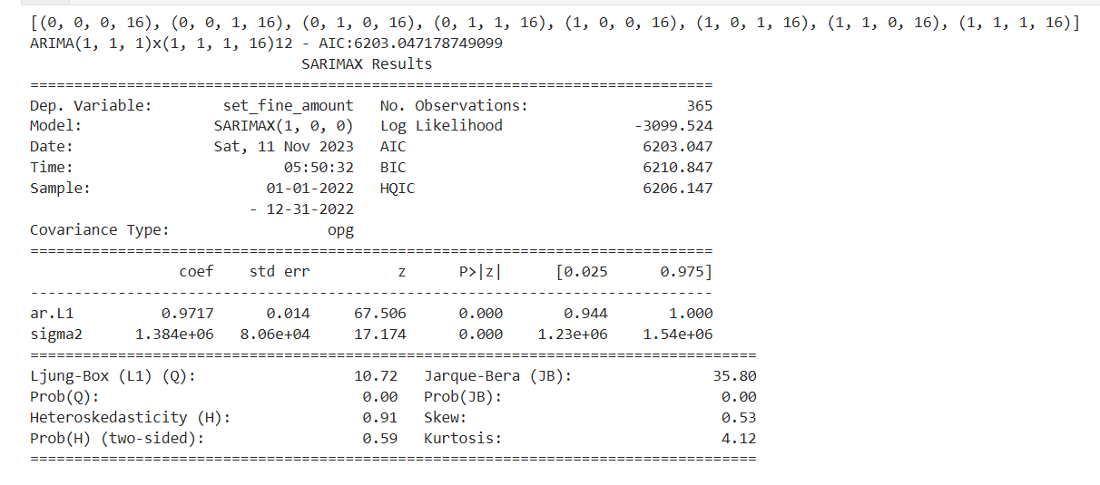
Choose the best variable which improve AIC, reduce skewness and heteroskedasticity
Before choosing the best value

Slide 20
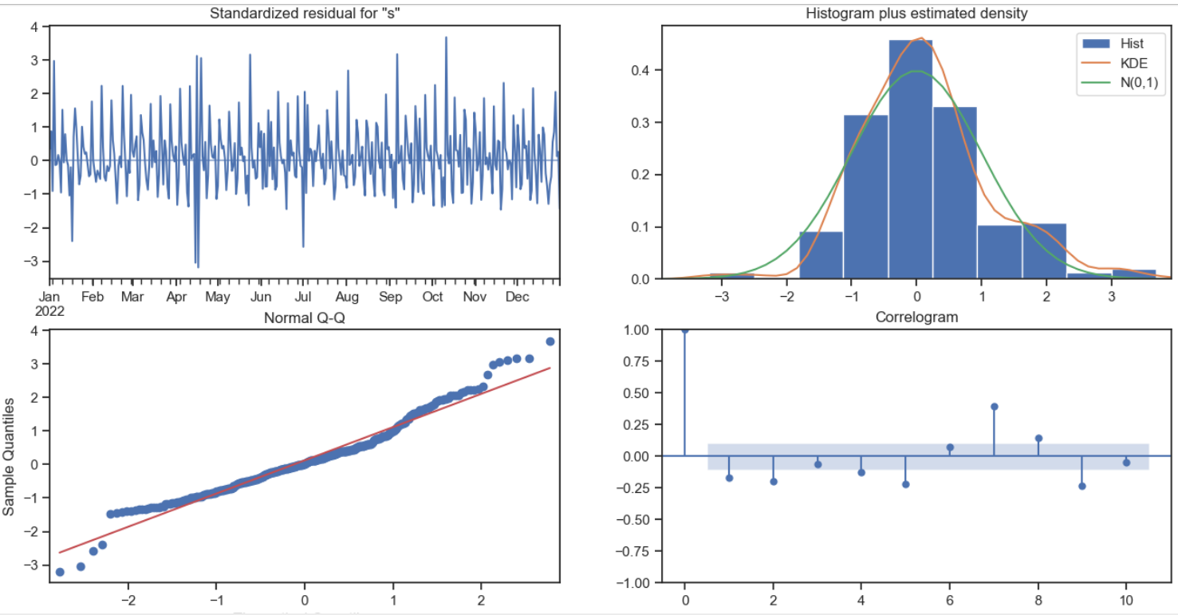
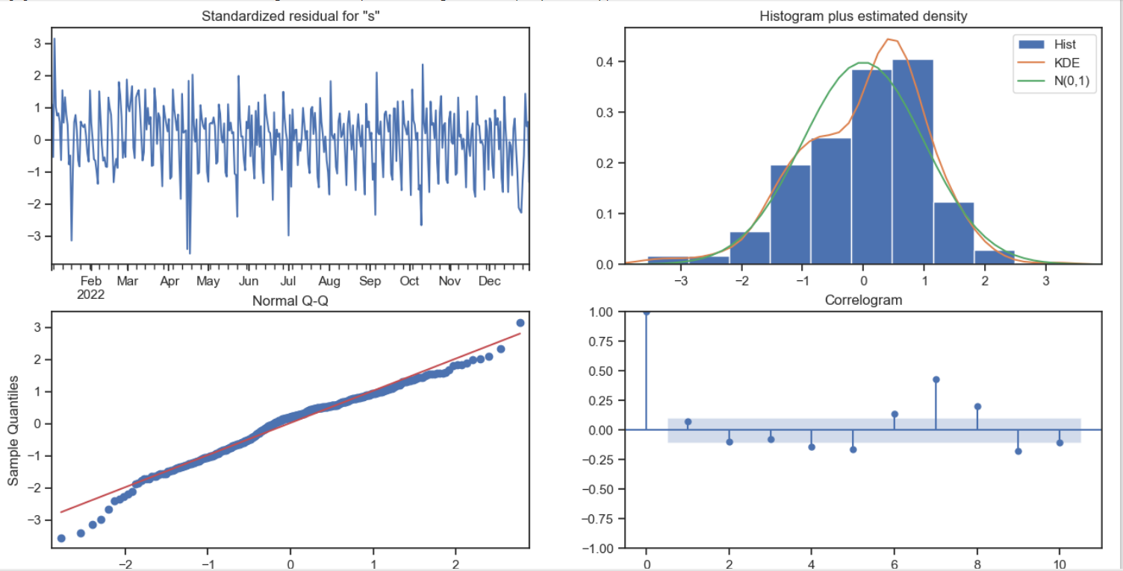
Diagnostic plot comparison
Before
After

Slide 21
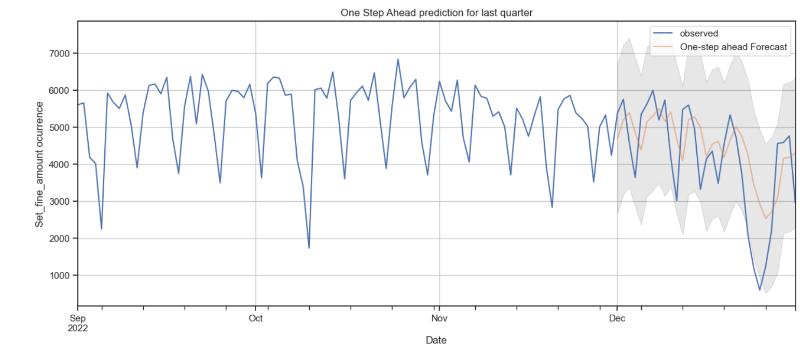
One Step Ahead Forecasting with the proven best value taken for last quarter

Slide 22
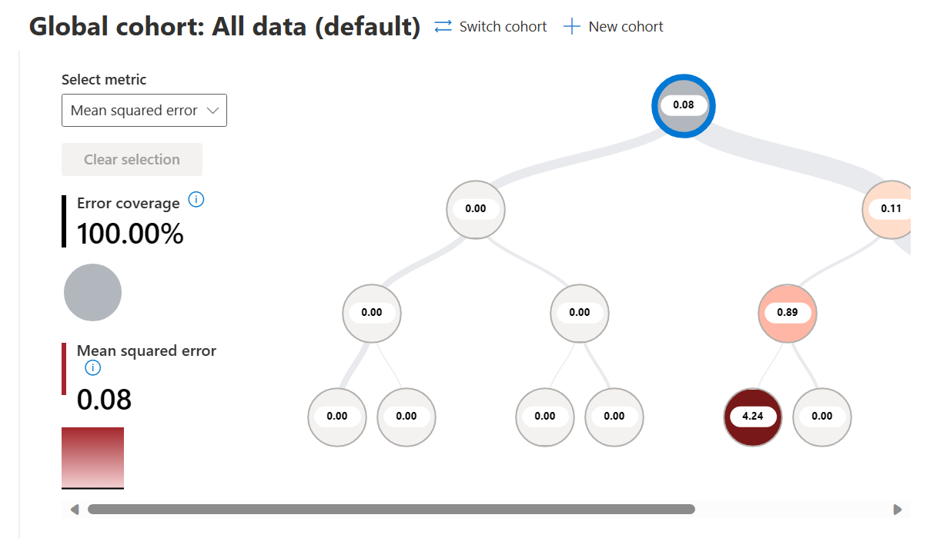
Feature Importance and fine prediction after Cleaning the Data with Responsible AI Toolbox
MSE = 0.081

Slide 23
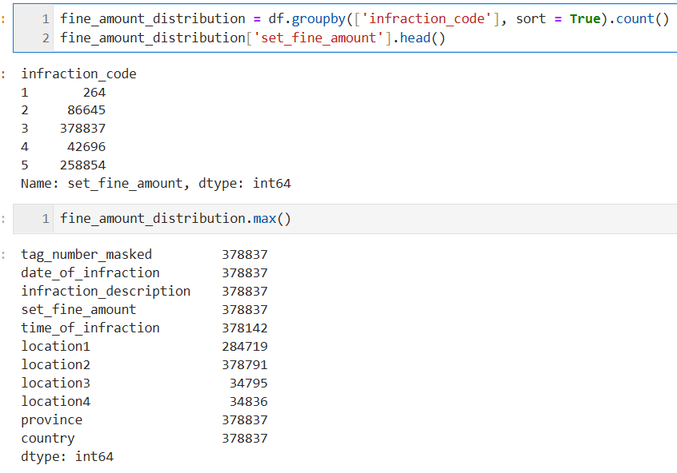
Highest occurred Infraction Code is 3 which occurs 378837 times.

Slide 24
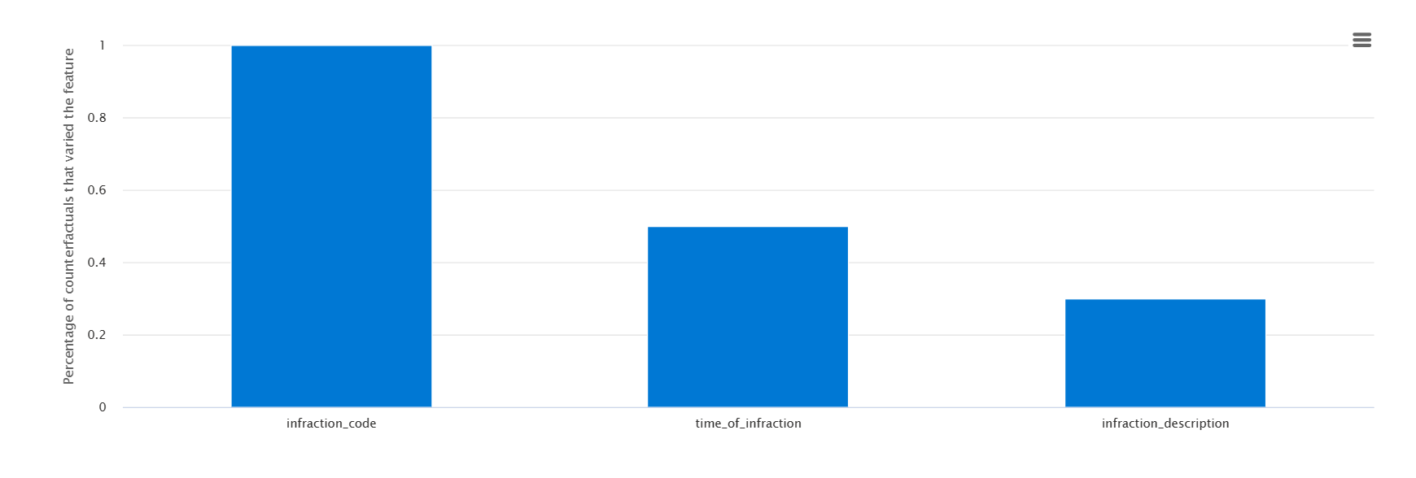
Top Features

Slide 25
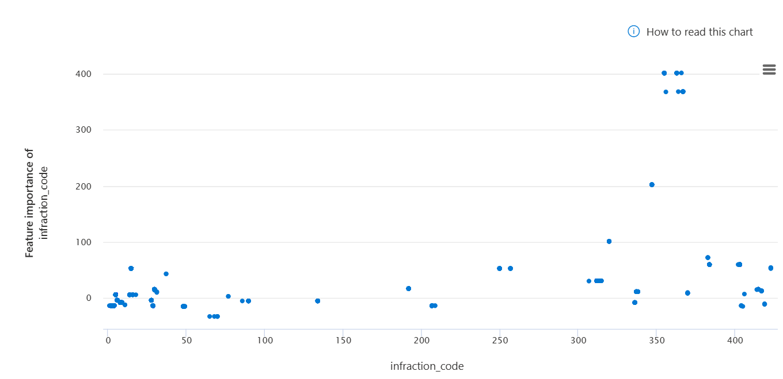
Feature Importance
Dependence plot of Infraction code’s importance value to it’s values.

Slide 26
Conclusion from the EDA
Ontario has the highest number of charged fine/parkit ticket which is 30 USD.
Even though number of occurrence is high for a particular category, feature importance could be different.
Skewness could be possibly reduced at higher proportion ( nearly 100%) which results better balance of distribution in time series data.
The model is undoubtedly performs good for fine amount for 1 year of data ( high accuracy and very low mse for random forest regression model ) but still only there are very less number of features which does not give the data a higher number of variance in terms of explainability.

Slide 27
Challenges and Areas of Development
The model has a tendency of overfitting.
IF we normalize the data too much in terms of skewness and other factors, we may loose some data could be a challenge of concept drift.
Solution For reaching more realistic nature and explainability:
We could introduce more features if available. The dataset should have some resource within it.
Increase the dataset’s compactness which could result in reuse faster.

Slide 28

Questions and Answers

